Slide 1






AAGS- SchoolTech

Slide 2
Problem Statement
Today, the Indian education system has developed into a system of mere schooling. The schooling part isn’t living up to the expectations of individuals either.
Education is being confined to schools and colleges and it has monotonously become a process of spoon feeding. We at AAGS believe that spoon feeding in the long run teaches us nothing but the shape of the spoon.
Students are unable to understand where they are lagging and how to improve themselves.
Teachers have to do all their work manually and due to too much work pressure, they often aren’t able to perform their best either.

Slide 3
OUR IDEA
We kept in mind factors which could help save time, money and
resources:
Adaptive learning.
Adaptive assignments.
VR based learning.
Similar questions preparation.
Live doubt clearance.

Slide 4
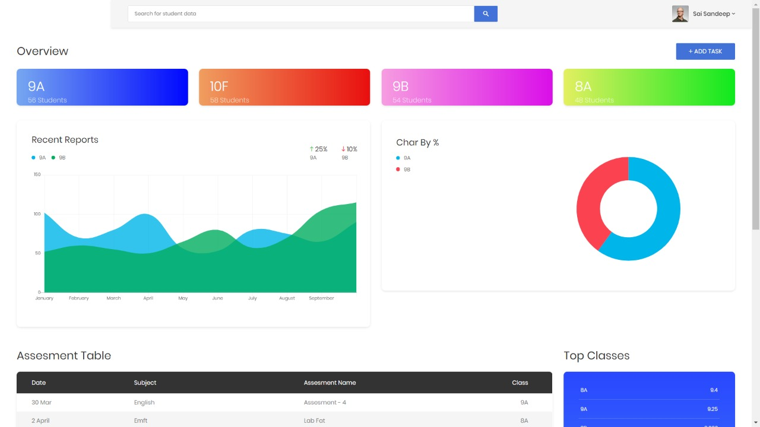
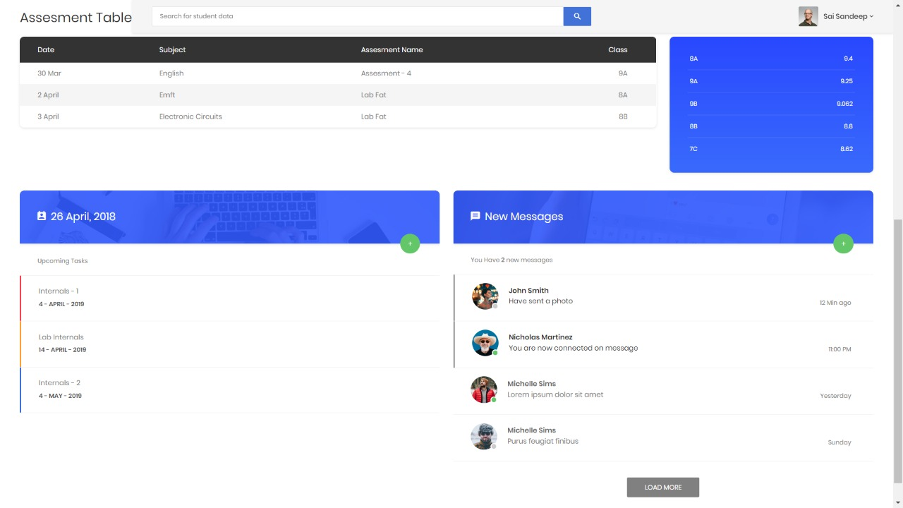

Slide 6
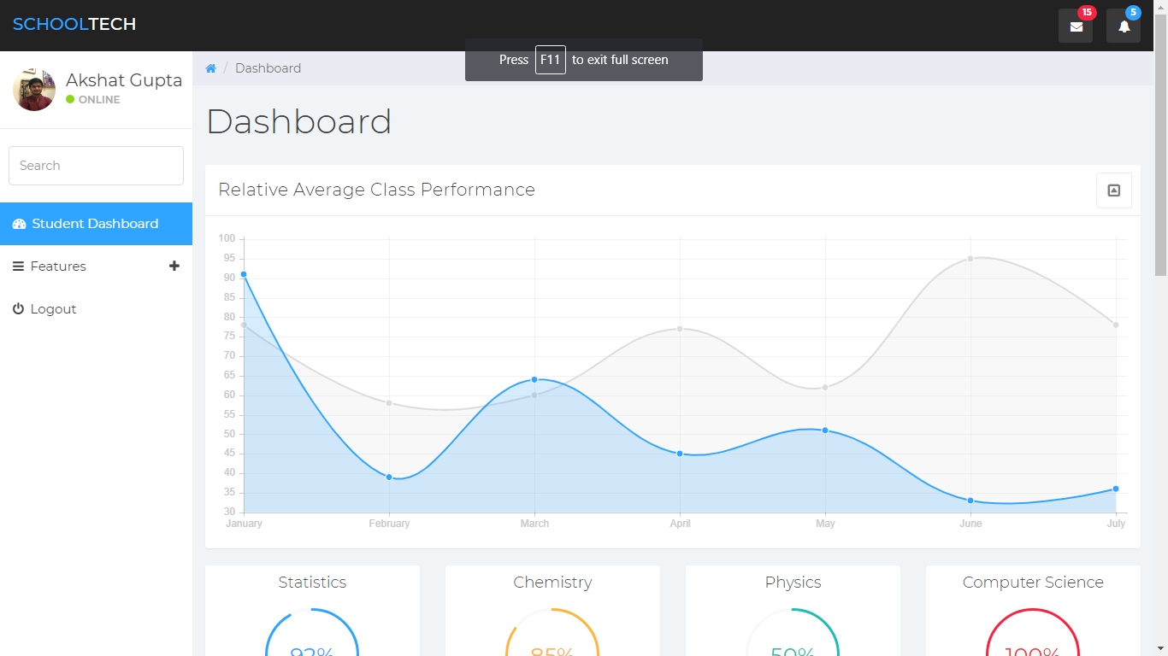

Slide 7
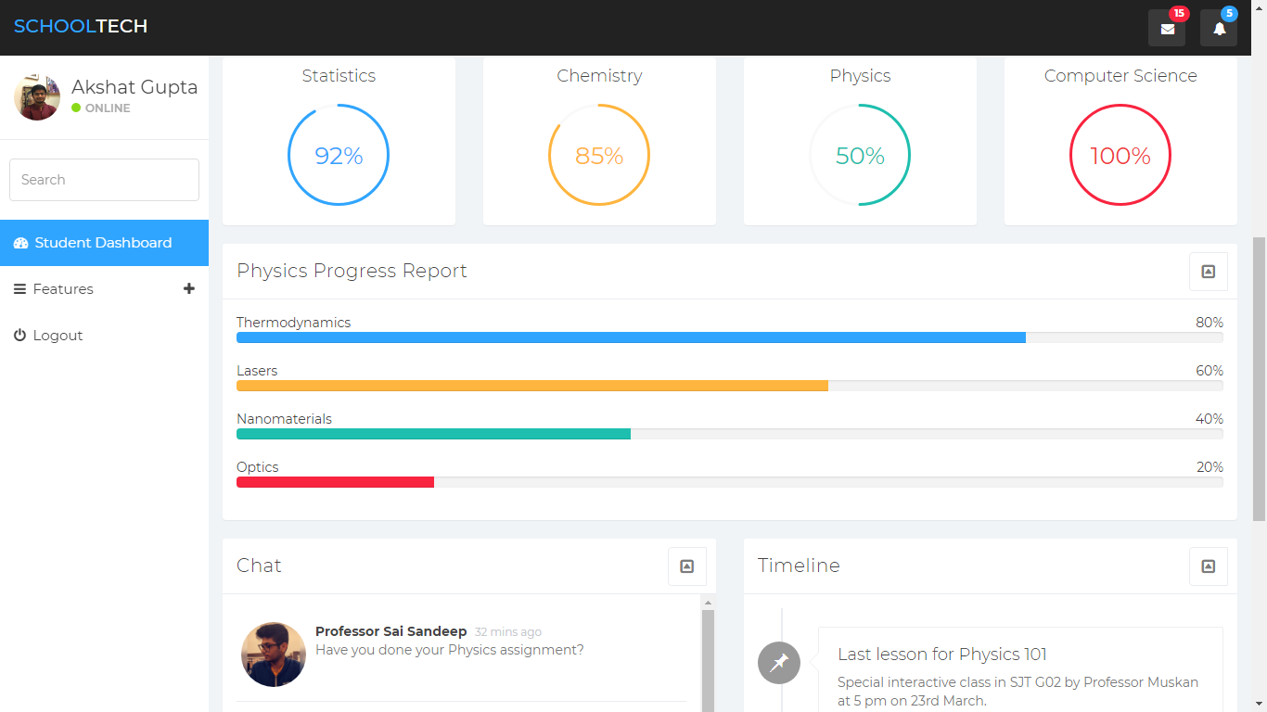

Slide 8
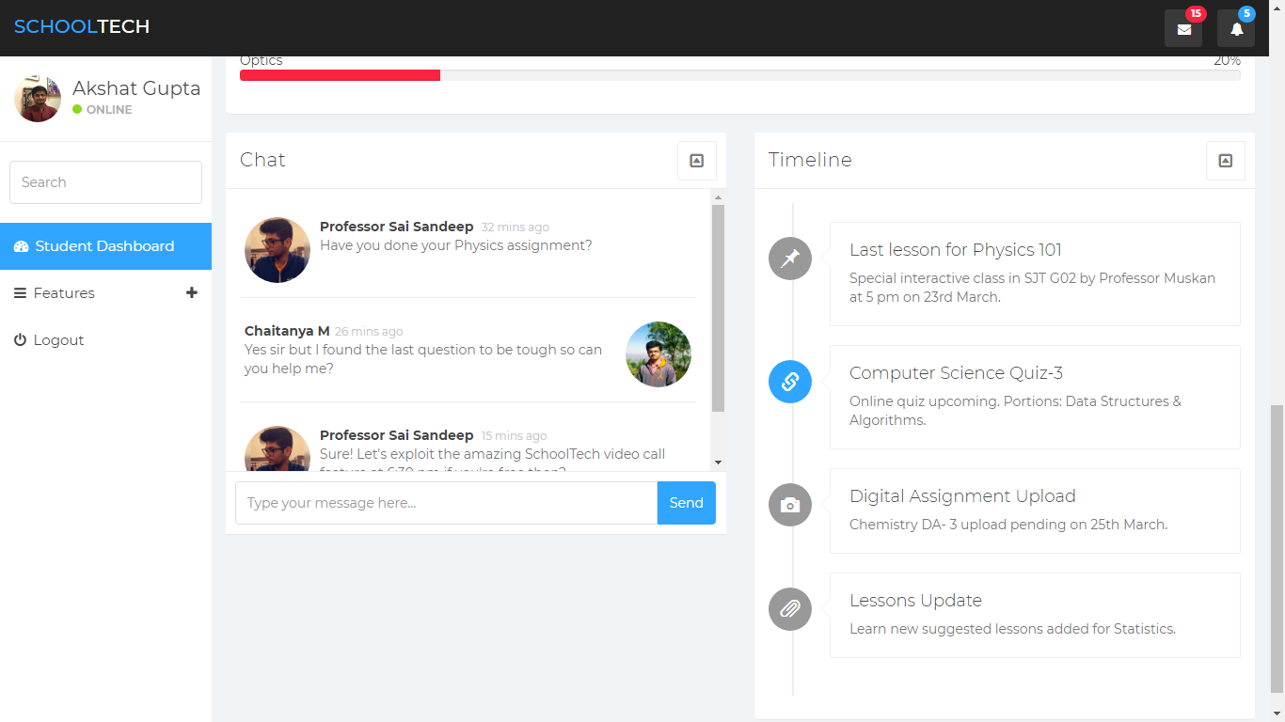

Slide 9
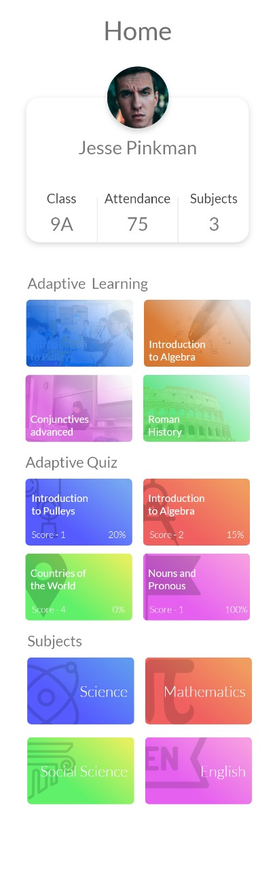
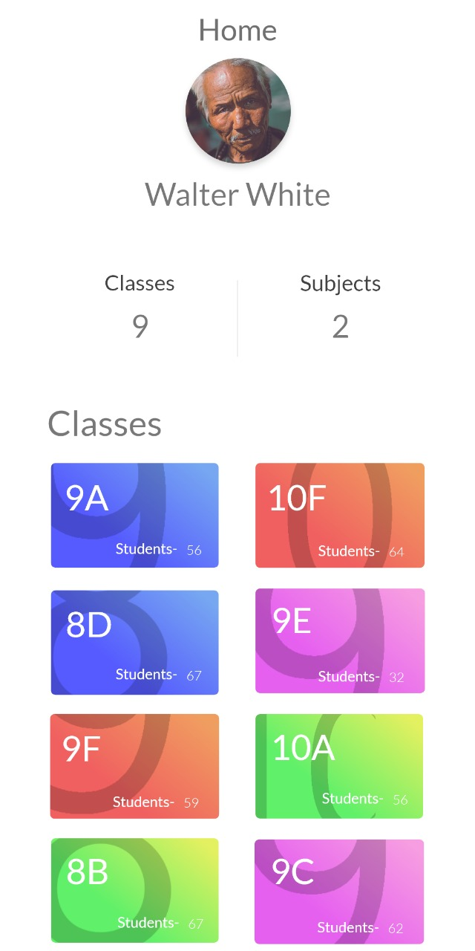

Slide 10




Industrial Analysis

Slide 11
How Are We Different?
Our models depend upon the students’ past performances and hence help find out courses and assignments suiting their level.
This ensures the slow learners are at par with the exceptional students.
Just because someone is a slow learner doesn’t mean he/ she deserves a 7 CGPA which will cause him/ her problems during placements.
At AAGS, we believe in equal opportunities for all.

Slide 12
Price Of Production
Rs 1,736 per month database and deploying costs.
Rs 199 per month for basic website hosting.
Rs 700 VR head set per customer.
Rs 1,000 per month.
Approximate total price for production on a small scale: Rs 3,636.

Slide 13
Revenue Model
We plan a B2B business model with businesses who are already excelling in their sectors.
Since we are freshers and or first timers, we don’t intend to pursue this as a personal startup but rather want to merge into a bigger company.
This way, we can come up with a deal on percentages from the company’s shares we partner with while simultaneously improving our idea.

Slide 14
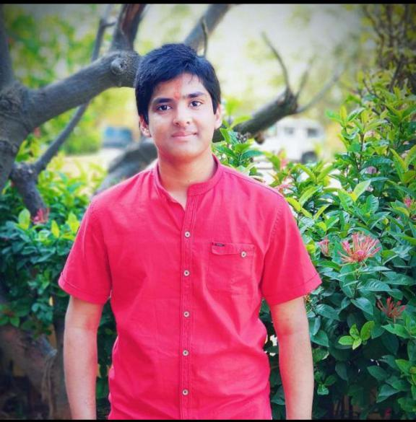
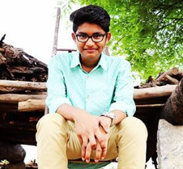
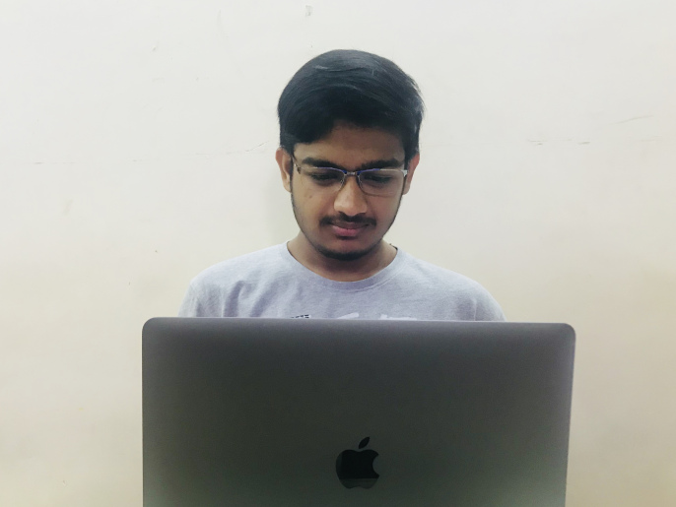
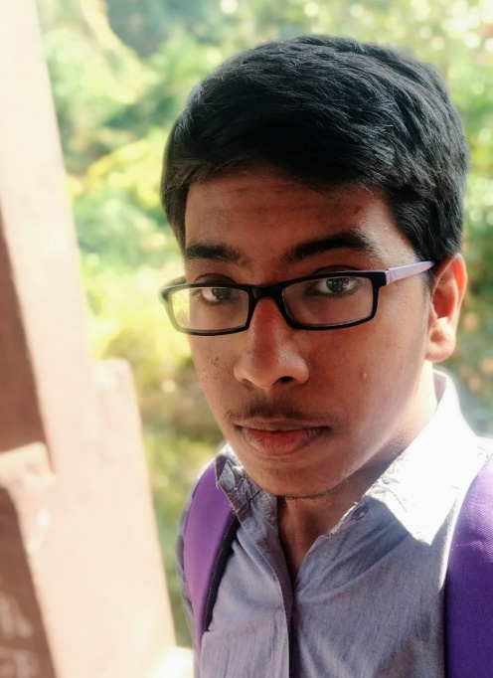
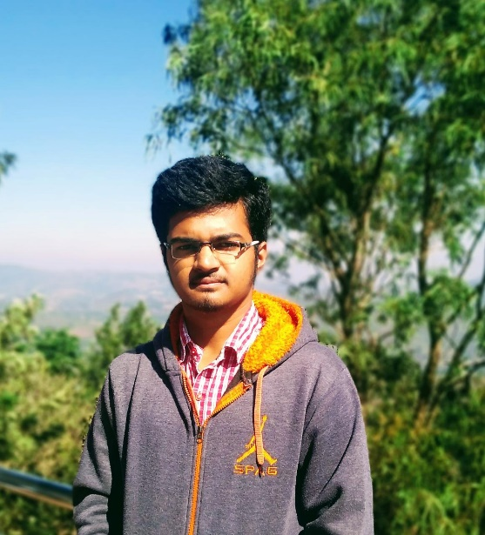
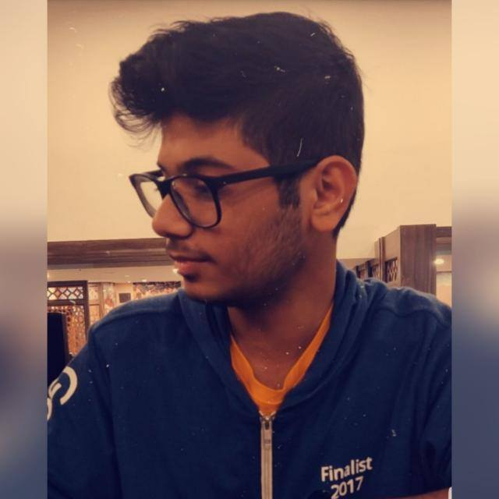
OUR TEAM
Arpit Jain
Akshat Gupta
Sai Sandeep
Chaitanya M
Aditya Rathore
Deepak Malpani

